Slide 1

Memory-Constrained Embedded System By Group - 12

Slide 2

Index
Problem Statement
solution
Working (Method/Mind map)
Conclusion.

Slide 3
Problem Statement
- Embedded systems operate in limited memory environments
- Memory write operations are costly and time-consuming
- Frequent writes can reduce hardware lifespan
- Traditional sorting algorithms perform many swaps
📊 Data Context:
Limited memory availability
Expensive write operations
📌 Objective:
Sort data efficiently
Minimize memory writes

Slide 4
Solution
⚙️ Approach:
Use Selection Sort Algorithm
Selects minimum element in each iteration
Performs fewer swaps compared to other algorithms
💡 Why Selection Sort?
Reduces unnecessary swaps
Minimizes memory write operations
Simple and effective for small datasets
📦 Deliverables:
Sorted dataset
Number of swaps
Memory write count
Comparison count

Slide 5
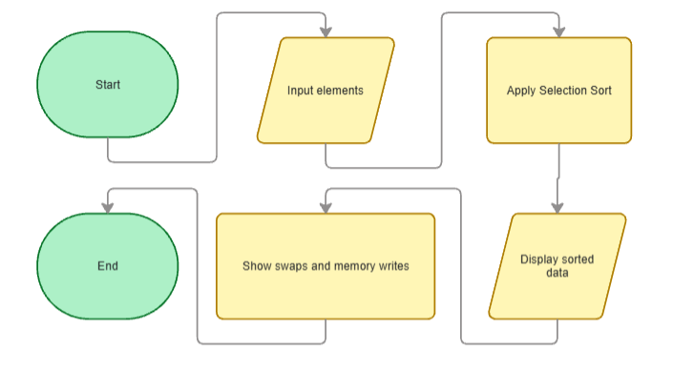
Working
🧠 Algorithm Steps
Take input from user
Store elements in array
Find minimum element in unsorted part
Swap only if required
Repeat until array is sorted
📊 Performance Tracking
Comparisons (checks between elements)
Swaps (exchange operations)
Memory Writes (data updates in memory)
🔄 Process Flow

Slide 6
Conclusion
📈 Outcome:
Successfully sorted dataset
Reduced number of swaps
Minimized memory write operations
Suitable for embedded hardware systems
✔ Efficient when memory writes are expensive
⚠️ Limitation:
Time Complexity: O(n²) Not suitable for large datasets

Slide 7
Thank You

